Slide 1

Superstore Sales Analysis
R Shiny app

Slide 2
Summary
This app analyzes Sales data for a Superstore
Data is Open Source from Kaggle. Data can be downloaded from the link below:
https://www.kaggle.com/datasets/vivek468/superstore-dataset-final
Analysis includes Geo Plot by State, Timeseries plots and trends, Tables and supplemental charts to help analyze Sales trends and Profits by Sales Category and Region
All Charts, Tables and Graphs throughout this presentation are interactive and will update based on user selection
At any time, user can restore the app to the default setting by hitting the “Reset” button on the home page
All files to run the app can be found here:
https://github.com/ckeller232/ShinyApp-DataVisualization
To run the app, user needs to have R and R-Studio version 4.1.2 or newer. Libraries required are in the top of the R-Studio (first code chunk).
***For the app to work best, open the app in a web browser once deployed.***

Slide 3
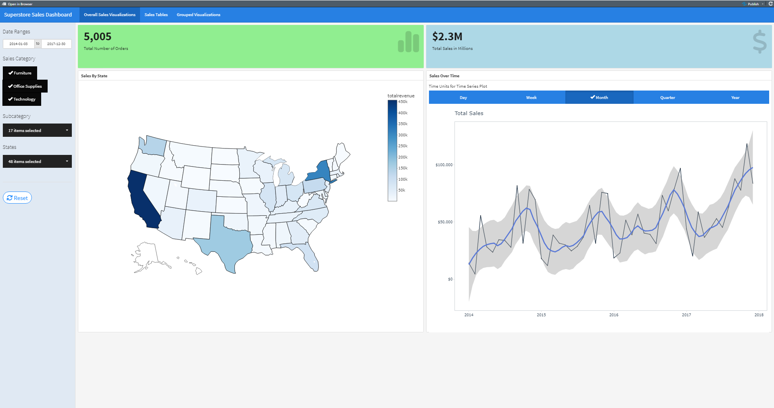
Overview – Main Page
The main page shows the Geo plot and overall Timeseries plot, with the total aggregated Number of Orders and Total Sales on the top bars. Here is where the user can select specific date ranges, categories, sub-categories and States of interest.
To reset, just hit the ‘Reset’ button shown on the taskbar. This will return to default settings. Navigation tab is circled in red.

Slide 4
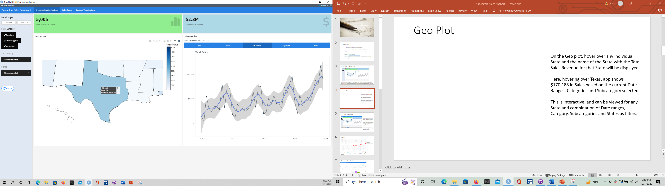
Geo Plot
On the Geo plot, hover over any individual State and the name of the State with the Total Sales Revenue for that State will be displayed.
Here, hovering over Texas, app shows $170,188 in Sales based on the current Date Ranges, Categories and Subcategory selected.
This is interactive, and can be viewed for any State and combination of Date ranges, Category, Subcategories and States as filters.

Slide 5
Time Series Plot
The Timeseries plot shows the trends for Sales by Year. Default is selected, and is in Months. However, user can change to look at Daily, Weekly, Quarterly and Yearly trends as well.
The actual trends are shown with by the black line with a smoothed trend in blue. The grey trendline indicates the range or estimated standard error for the trend.
This plot is an aggregate for Sales, but user can also look at different Date ranges, Categories, Subcategories and States for the Timeseries.

Slide 6
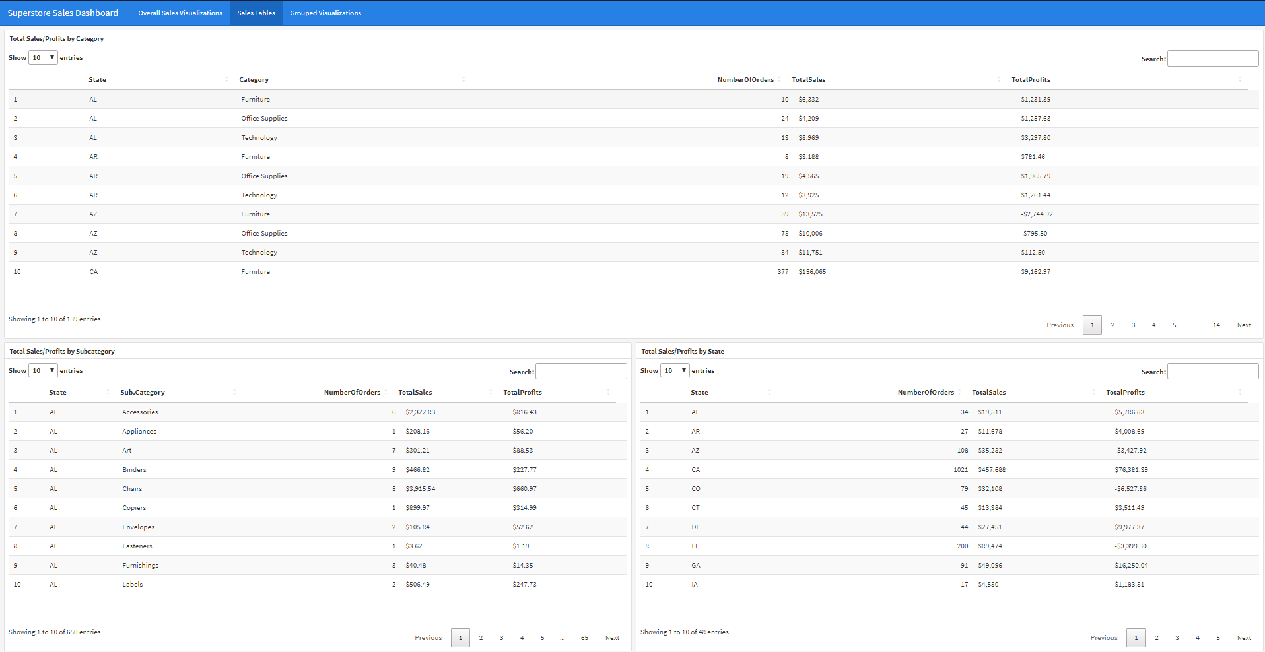
Tables
Table Header:
Shows what the Table is aggregated by.
The second page of the app gives Table summaries based on the selected Date ranges and Categories. These tables are interactive, and will update based on user selection.
Each table shows summaries of Number of Orders, Total Sales and Total Profits, based on different grouping provided in the Table header.

Slide 7
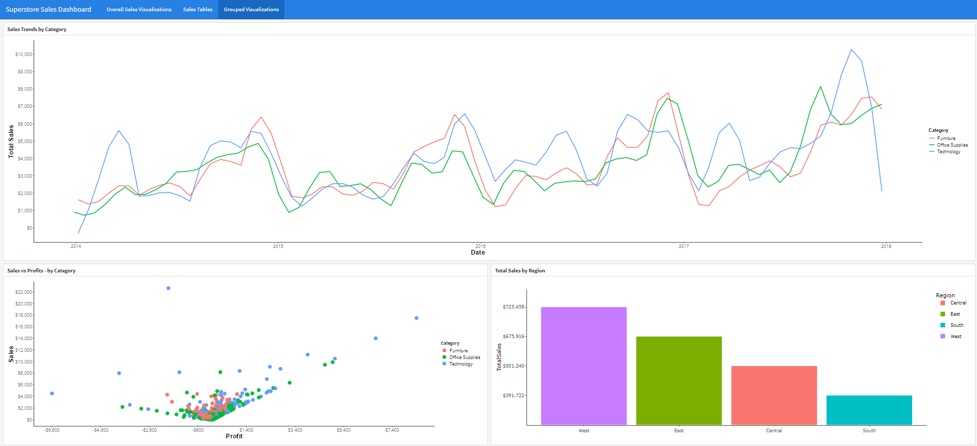
Grouped Visualizations
The third page of the app shows a Timeseries plot for comparing the different Categories individually, along with a plot to analyze trends between the Sales price of the individual Order ID by Total Profit for that Sale (grouped by Category). The bottom right plot shows the Total Sales by Region.
All these plots are interactive, and can be modified by Date Range, Category, Subcategory and State by user input on the home page.

Slide 8
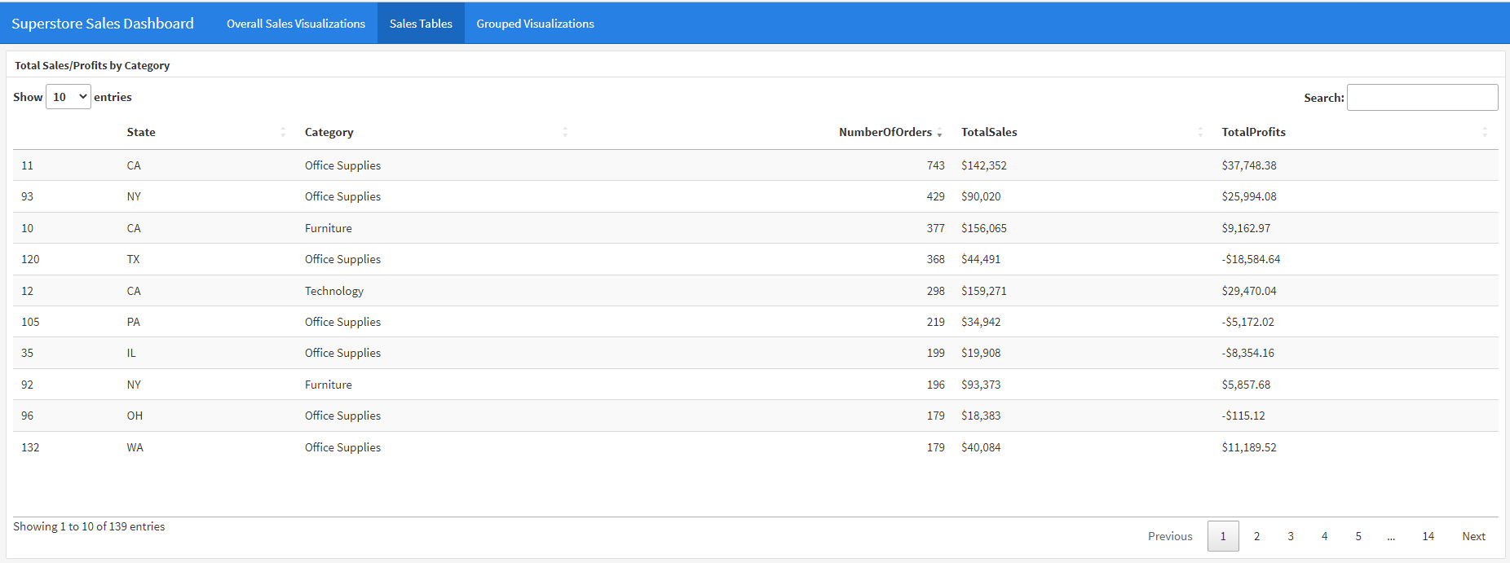
Analysis – Where do Orders,Sales and Profits come from?
From the Geo Plot and the Tables page, we see that CA, NY and TX have the highest Sales Revenue. Using the Tables page and ordering by Orders and Sales, we see CA, NY and TX purchase a lot of Office Supplies and Furniture, also contributing to a lot of Profits.
TX does show, however, negative Profits when buying Office Supplies. We will break down those losses as well.

Slide 9
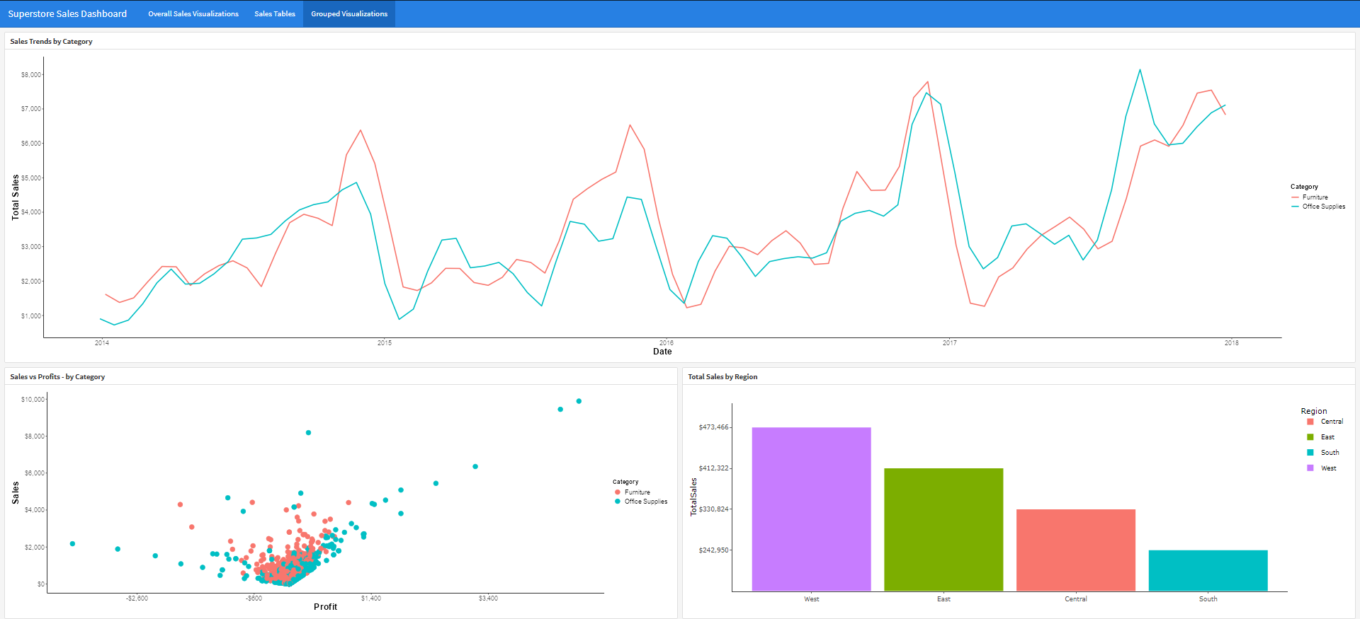
Analyzing Grouped Visualizations
Turning off ‘Technology’ on the main page, we can focus on Furniture and Office Supplies. We see better Profits from Office Supplies when looking at Sales vs Profits plot, even though the Sales Timeseries plots look very similar for the 2 groups. What Office Supplies offer the highest Profits?

Slide 10
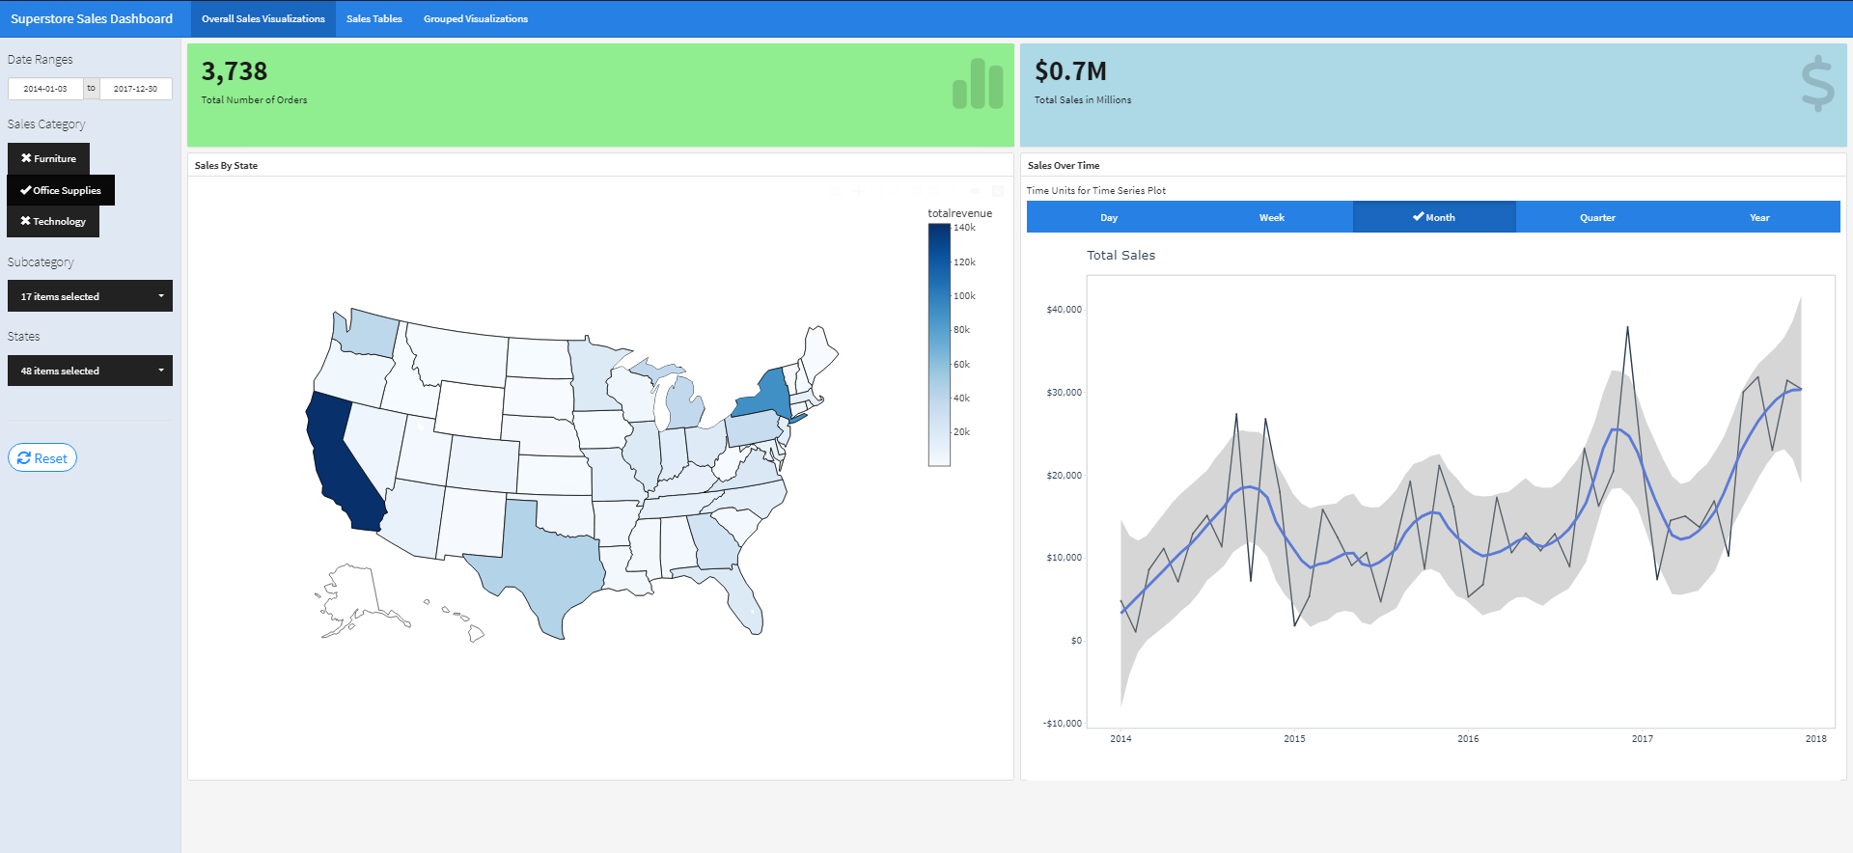
Office Supplies – A Deep Dive
On the Overall Sales page, we have turned off Furniture and Technology to analyze Office Supplies. The Geo Plot shows where the Sales are highest (CA, NY, TX) indicated by the color. We also see the total aggregated number of Orders and Sales in Millions, along with Sales Revenue over time on the Time Series plot.
(If we wanted to, we could also use filters to select these States only, but did not do that in this example).

Slide 11
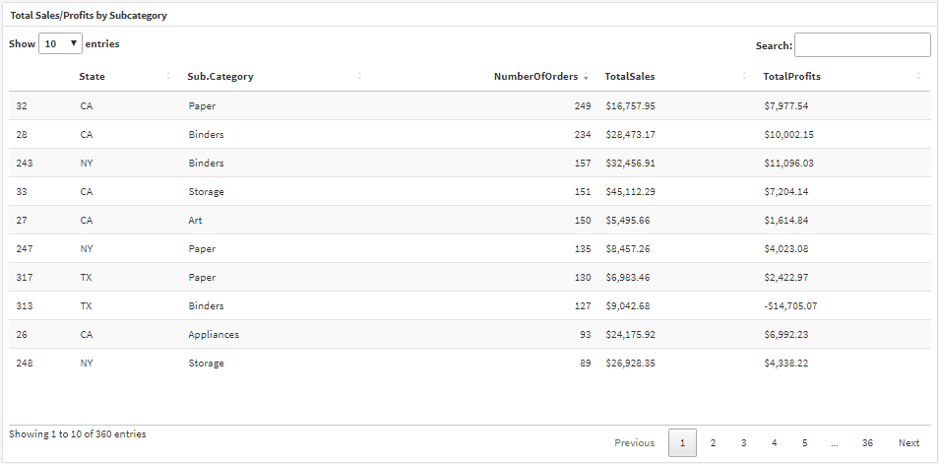
Office Supplies – A Deep Dive Cont’d
Table of Total Sales and Profits shows most Sales and Profits come from selling Paper and Binders, primarily in CA and NY which matches the Geo Plot.
The Superstore does show Profits when selling Paper in TX, but shows significant Profit losses when selling Binders in this State.

Slide 12
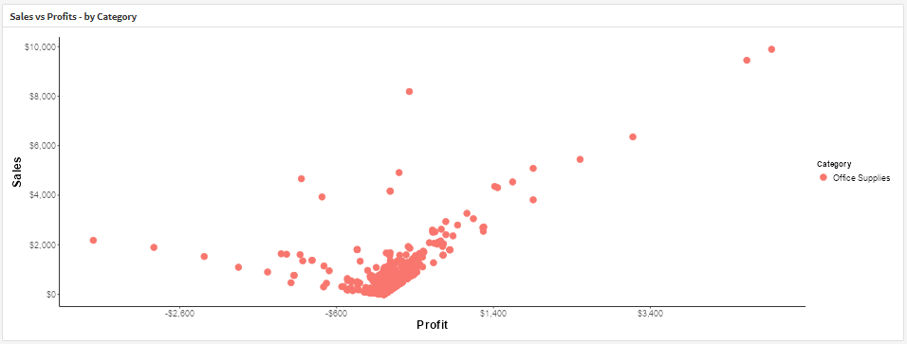
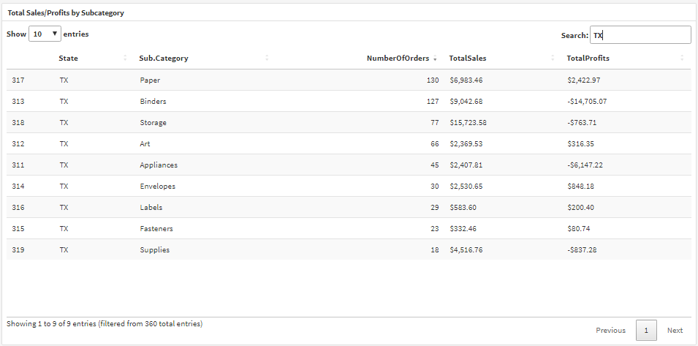
Office Supplies – A Deep Dive Cont’d
From the Sales vs Profit plot, it is noticed there are some Sales with significant Profit losses (highlighted in red).
When looking into TX (where we saw negative Profits on the aggregated table), we see heavy losses when selling Binders and Appliances. This is the most likely contributor to the losses seen on the Sales vs Profits plot.

Slide 13
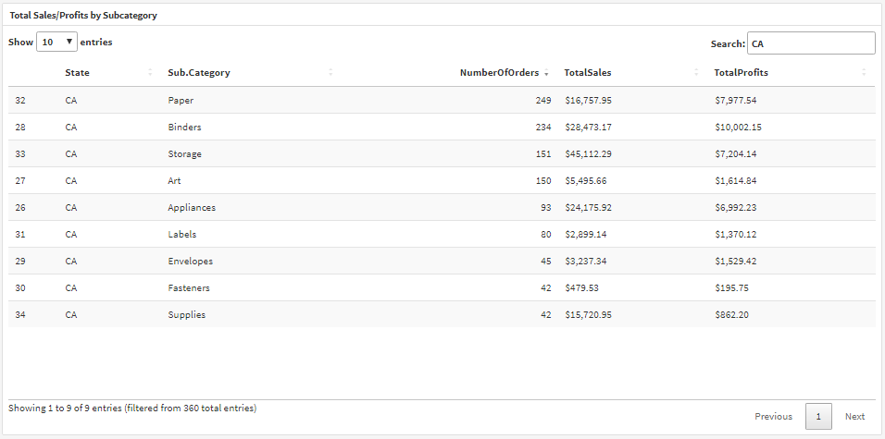
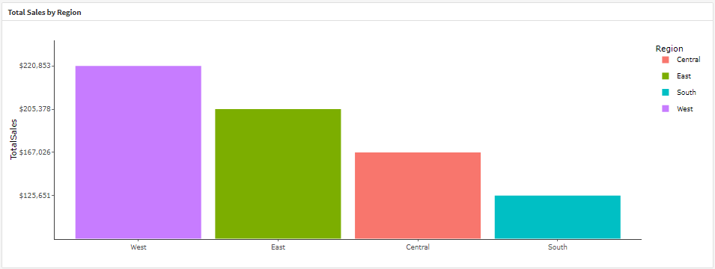
Office Supplies – A Deep Dive Cont’d
CA shows Profits across all Subcategories of Office Supplies (as indicated by the Table). These Sales are most likely what we see on the Sales vs Profits plot to help explain what is the cause.
It can be also noted California is a likely contributor to high Sales in the Western region when looking at the Total Sales by Region graph.

Slide 14
Conclusion Summary
This is an example of what the app can be used to analyze and what can be developed using R Shiny.
A deeper dive can be looked at as well, looking into other specific Categories, Subcategories and Date ranges using the filters in the app.
Using these filters allows the user to look at additional Trends, Tables, Regional, and Sales vs Profits plots.

